Slide 1
Data-driven Machine Perception
Ricard Marxer & Santiago Cuervo
Université de Toulon
Deep Learning. Master MIR 2024

Slide 2
Data-driven Machine Perception

Slide 3
Data-driven Machine Perception
Machine Learning …

Slide 4
Data-driven Machine Perception
Machine Learning …
… on perceptual data (e.g. images, audio)

Slide 5
Course outline
Problem definition
Research question(s)
Data and compute budget
Objectives, baselines and metrics
Work plan
Deliverable:
Group presentations on February 19th

Slide 6
Course outline
Problem definition
Research question(s)
Data and compute budget
Objectives, baselines and metrics
Work plan
Deliverable:
Group presentations on February 19th
Experimental setup
Working codebase
Baseline results
Re-evaluation of objectives and work plan
Deliverable:
Report to supervisor on March 14th

Slide 7
Course outline
Problem definition
Research question(s)
Data and compute budget
Objectives, baselines and metrics
Work plan
Deliverable:
Group presentations on February 19th
Experimental setup
Working codebase
Baseline results
Re-evaluation of objectives and work plan
Deliverable:
Report to supervisor on March 14th
Conclusions
Overall results and analyses
Future work
Deliverable:
Group presentations and report on March 25th

Slide 8
Guidelines
Problem definition can be tricky. A good recipe is to replicate someone else’s research and then propose a small step beyond it (Ricard and I will propose a few of our own).
We want you to get experience with real deep learning research setups and good practices. Therefore we require you to:
Use code repositories and version control (e.g. GitHub, GitLab)
Use tools for experiment tracking (e.g. Wandb, CometML)
Use a GPU cluster. You can work in Colab/Kaggle if you find it more convenient, but your work has to be reproducible in our cluster (and you must prove it)

Slide 9
Questions?

Slide 10
Project proposal:
Speech representations for predicting listeners perception

Slide 11
Background: Speech Perception Prediction
The goal is to predict what a listener will perceive from an audio input.

Slide 12


Background: Speech Perception Prediction
The goal is to predict what a listener will perceive from an audio input.
Speech perception
Speech
Bob
Most speech applications:
ASR: “speech”
Speaker classification: Bob

Slide 13

Background: Speech Perception Prediction
The goal is to predict what a listener will perceive from an audio input.
Speech perception
Speech
Noisy rain background
Bob
Most speech applications:
ASR: “speech”
Background classification: rain
Speaker classification: Bob

Slide 14

Background: Speech Perception Prediction
The goal is to predict what a listener will perceive from an audio input.
Speech perception
Speech
Noisy rain background
Peach 🍑
Bob
Alice
Most speech applications:
ASR: “speech”
Background classification: rain
Speaker classification: Bob
Speech perception:
Correctness prediction: 66.7%
Response prediction: peach

Slide 15
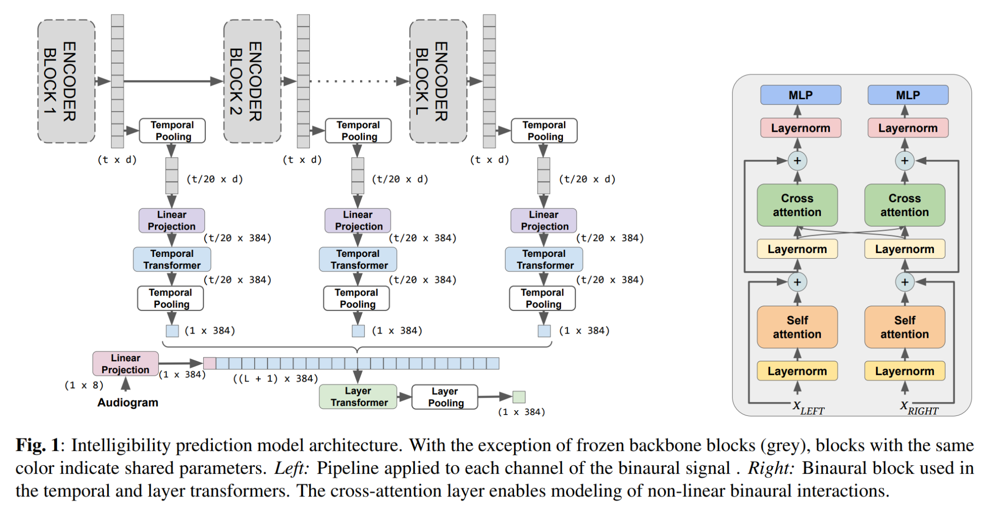
Our research on speech perception prediction and how you can play with it/contribute to it
[Our paper] We built a prediction model that uses self-supervised learned speech representations and a custom-designed transformer model to extract information from them.

Slide 16

Our research on speech perception prediction and how you can play with it/contribute to it
[Our paper] We built a prediction model that uses self-supervised learned speech representations and a custom-designed transformer model to extract information from them.
And we won 1st place in the Clarity Prediction Challenge 2023 🥳

Slide 17
Our research on speech perception prediction and how you can play with it/contribute to it
Things you can do:
Experiment with the different hyperparameters of our model and try to better understand the performance and improve it. E.g.
Apply the model to new data / using different speech representations.
Analyze the influence of the different design choices of our model. Maybe we could have gotten an even better model? We have reasons to think so.

Slide 18
References
Speech foundation models on intelligibility prediction for hearing-impaired listeners: our paper.
The 2nd Clarity Prediction Challenge

Slide 19
Project proposal(s):
Speech Language Models

Slide 20
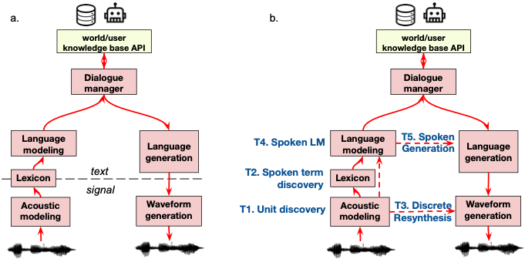
Background: Zero Resource Speech Challenge
The end-game is to build a spoken dialogue system directly from raw audio recordings. No text involved.
a. Traditional pipeline for a spoken assistant based on textual resources.
b. Pipeline and tasks for the Zero Resource Speech Challenge.
Taken from https://www.zerospeech.com/

Slide 21
Background: Zero Resource Speech Challenge
Motivations:
Open up applications in low-resource languages, therefore making AI dialogue systems more inclusive.
Potentially more expressive than text-based systems.
Could provide hints on human language acquisition.

Slide 22
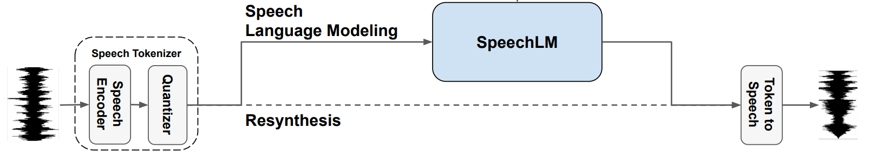

Speech Language Models (SLMs)
Demo:
Prompts =
Prompts + completions =

Slide 23
Our research on SLMs and how you can play with it/contribute to it
[To be published] We built an open source version of Google’s AudioLM (top SLM to date), and have evaluated its linguistic performance (think of the English proficiency evals of the DL4Sequences lab). Things you could do:
Evaluate other speech tokenizers in our framework.
Implement additional evaluations that measure the quality of the generated speech at the acoustic level (E.g. how accurately can a speech recognition system understand our generated speech? How accurately can a classifier tell apart real from generated speech?).
Apply our implementation to music instead of speech.

Slide 24
Background Pt. 2: Scaling laws for SLMs
Following two slides on scaling laws taken from Jason Wei’s slides

Slide 25
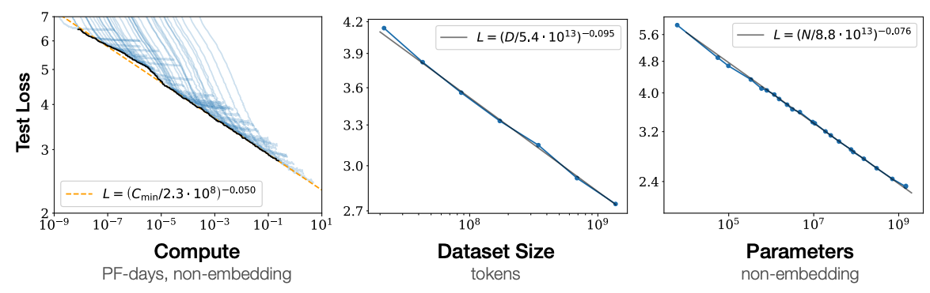
Scaling laws
Kaplan et al., 2020: Language modeling performance improves smoothly as we increase the model size, dataset size, and amount of compute for training.
A lot of compute
(log scale!)
Note 1: “Within reasonable limits, performance depends very weakly on architectural hyperparameters such as depth and width.”
What does 1 better loss look like?
Note 2: By the way, data is unlabeled (self-supervised) data from the internet (e.g., common crawl).
Jason’s rephrase: You should expect to get a better language model if you scale up model size, dataset size, and amount of compute.
Scaling laws for neural language models (2020).
Suggested further reading:
Scaling laws for neural language models (2020).
Training compute-optimal large language models (2022).

Slide 26
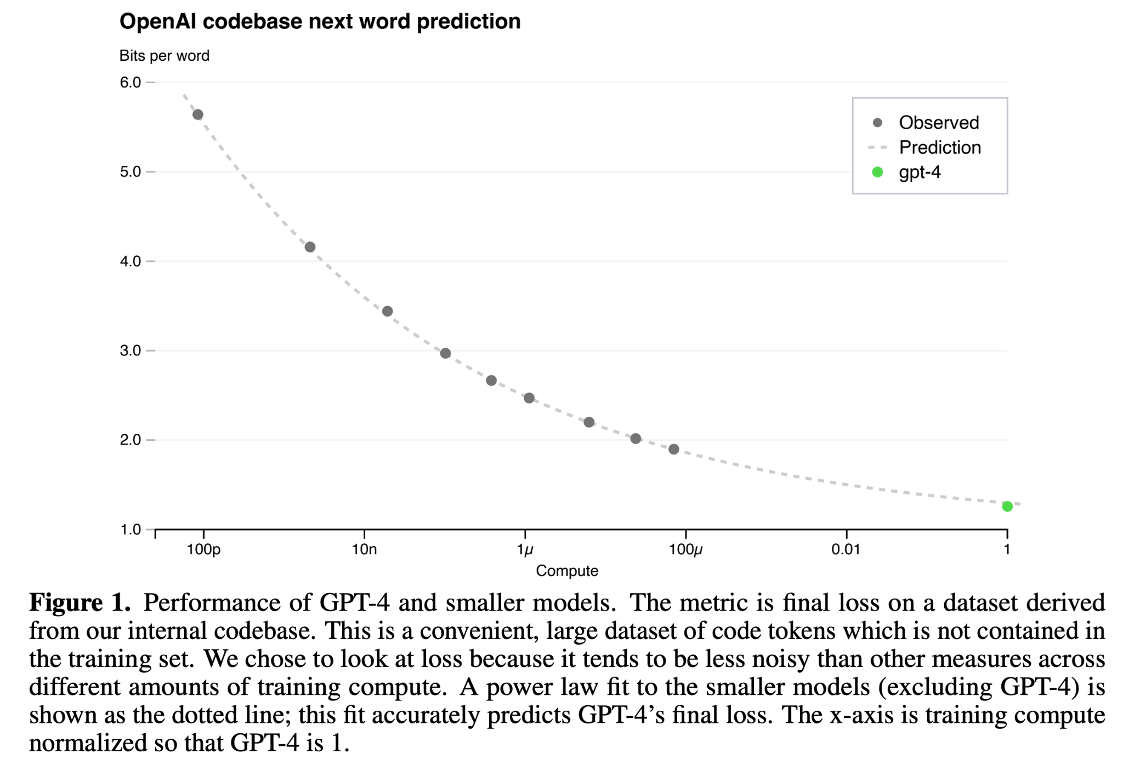
Scaling laws: can be very predictable
Predictable with models of up to 10,000x less compute
GPT-4 technical report (2023).
Suggested further reading:
GPT-4 technical report (2023).

Slide 27
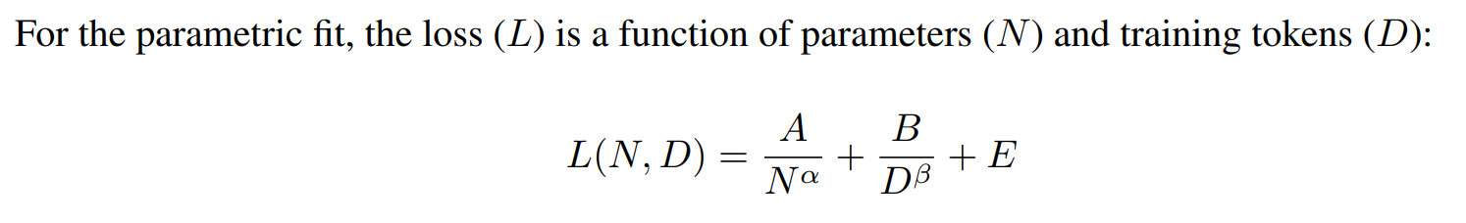
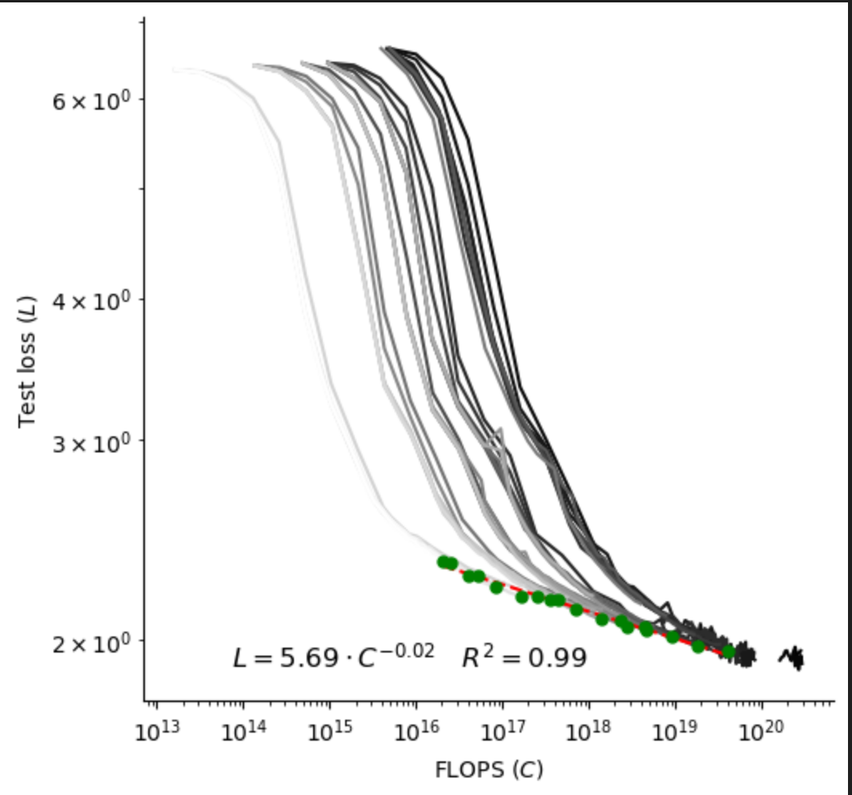
Our research on scaling laws for SLMs and how you can play with it/contribute to it
[To be published] We have derived scaling laws for speech language models:
Things you could do:
Use our scaling laws to predict in advance the performance of several SLMs with different setups.

Slide 28
References
Generative Spoken Language Modeling from Raw Audio: original proposal of Speech Language Models.
AudioLM: a Language Modeling Approach to Audio Generation: state-of-the-art speech language model (closed source, we have replicated it using open source models).
Training Compute-Optimal Large Language Models and Scaling Data-Constrained Language Models: scaling laws of language models (for text. We use a similar model for speech).

Slide 29
Project proposal:
LLM agents on sequential social dilemmas

Slide 30
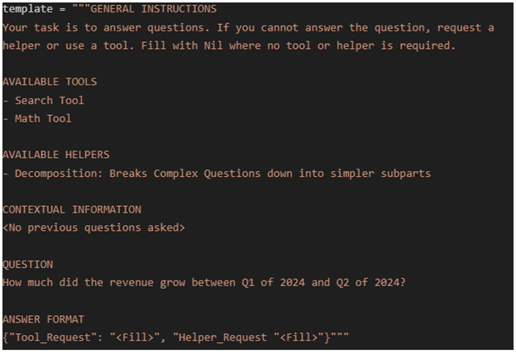
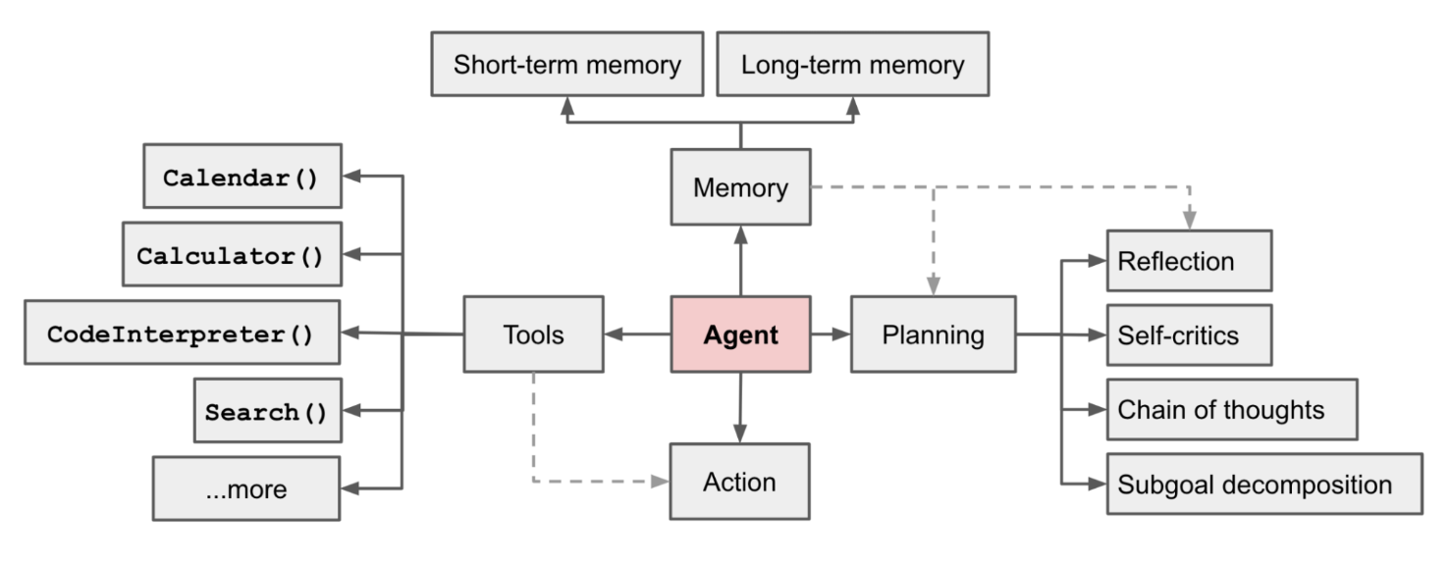
Background: LLM agents
Goal-directed LLMs capable of interacting with the world (virtual or physical) using a perception/action cycle.

Slide 31
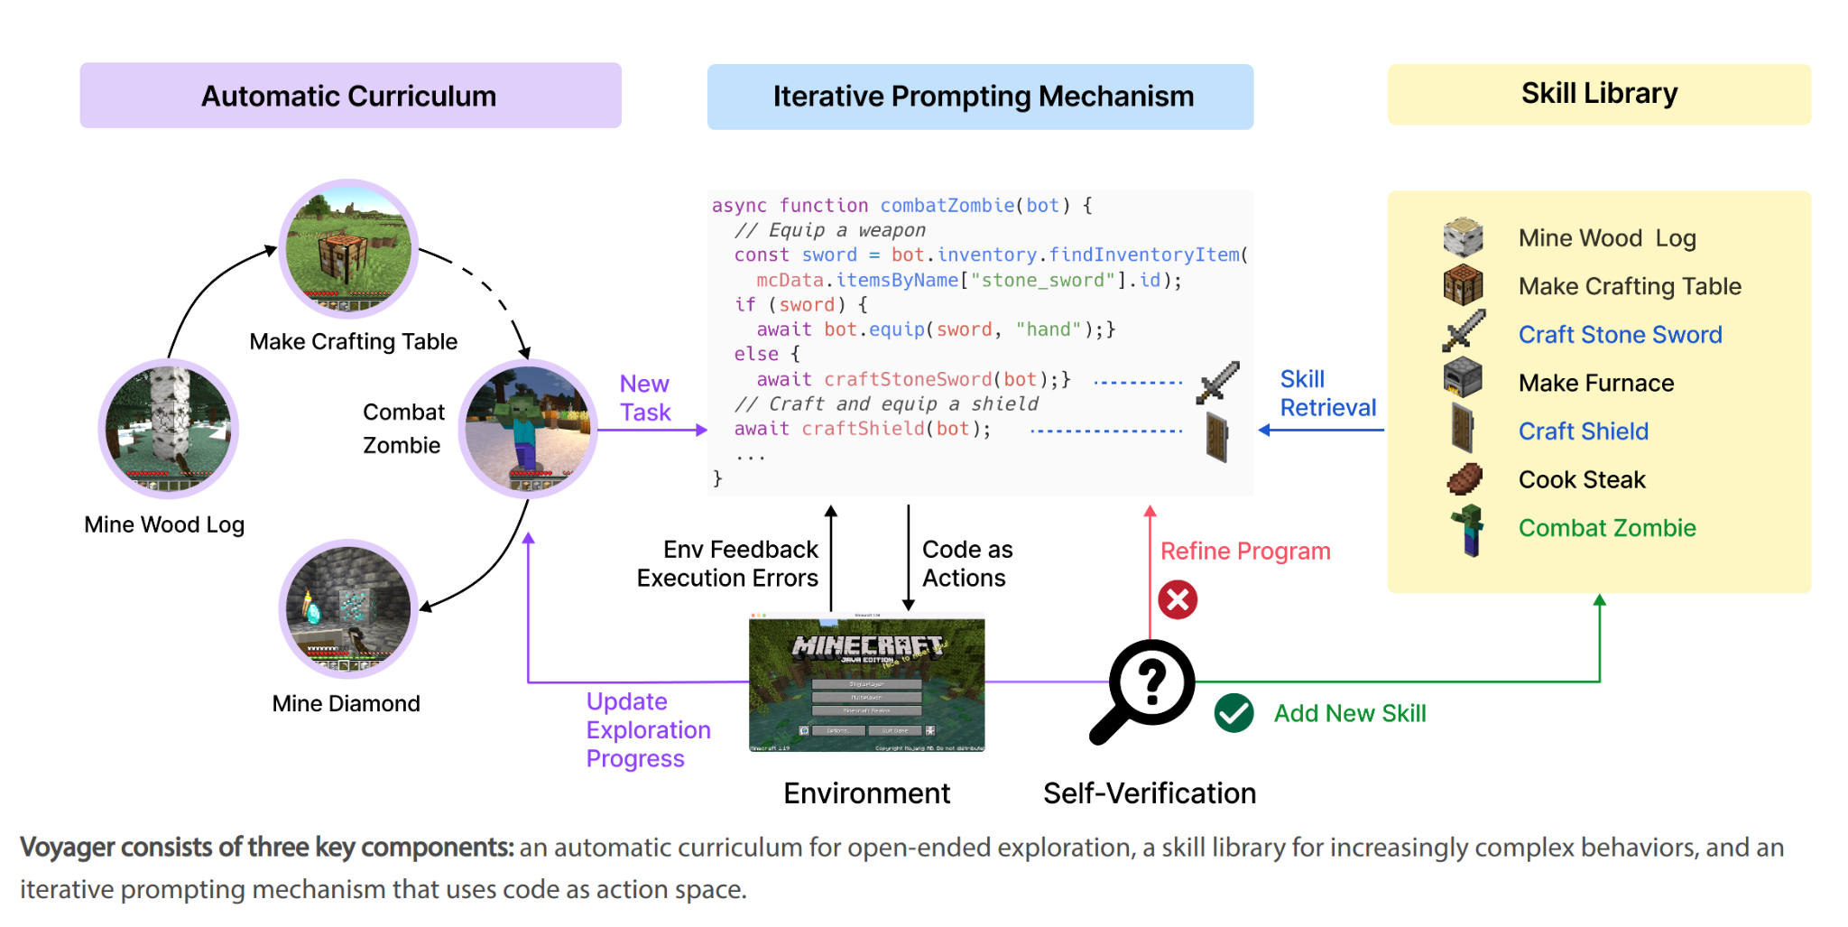
A super cool example: Voyager, a LLM that plays Minecraft

Slide 32
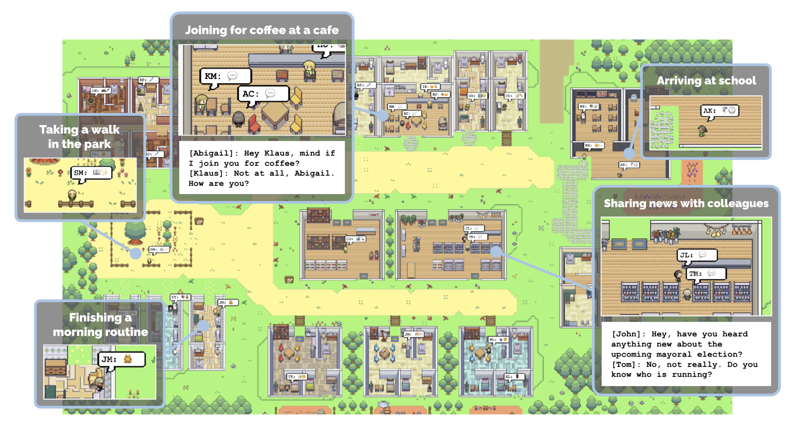
Another cool example: A community of AIs

Slide 33

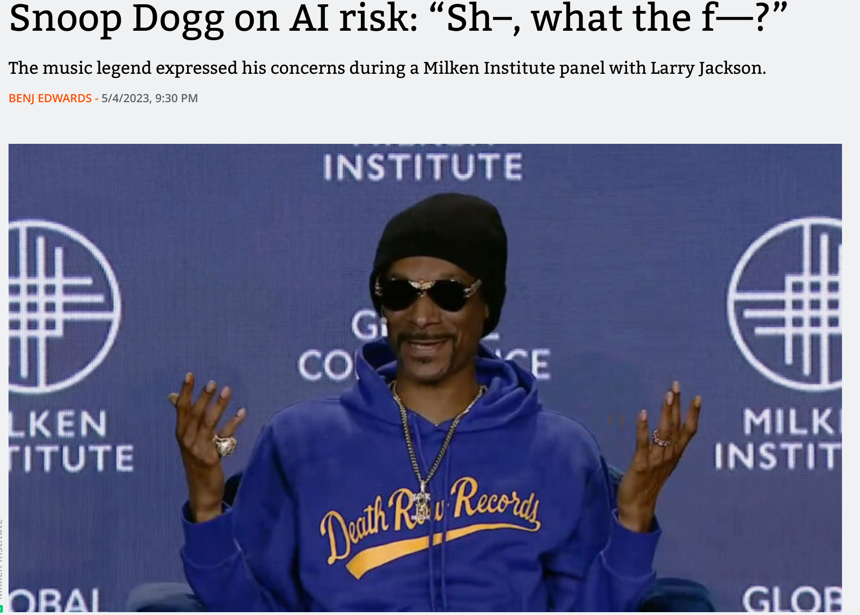
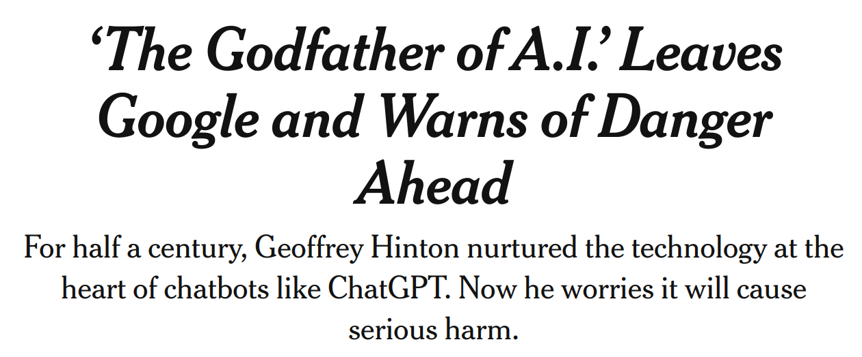
Background: AI alignment
Some experts (and not so experts) believe that AI agents might be dangerous because they may not be aligned. i.e. they might behave unpredictably, and maybe not in our benefit or according to our morals.

Slide 34
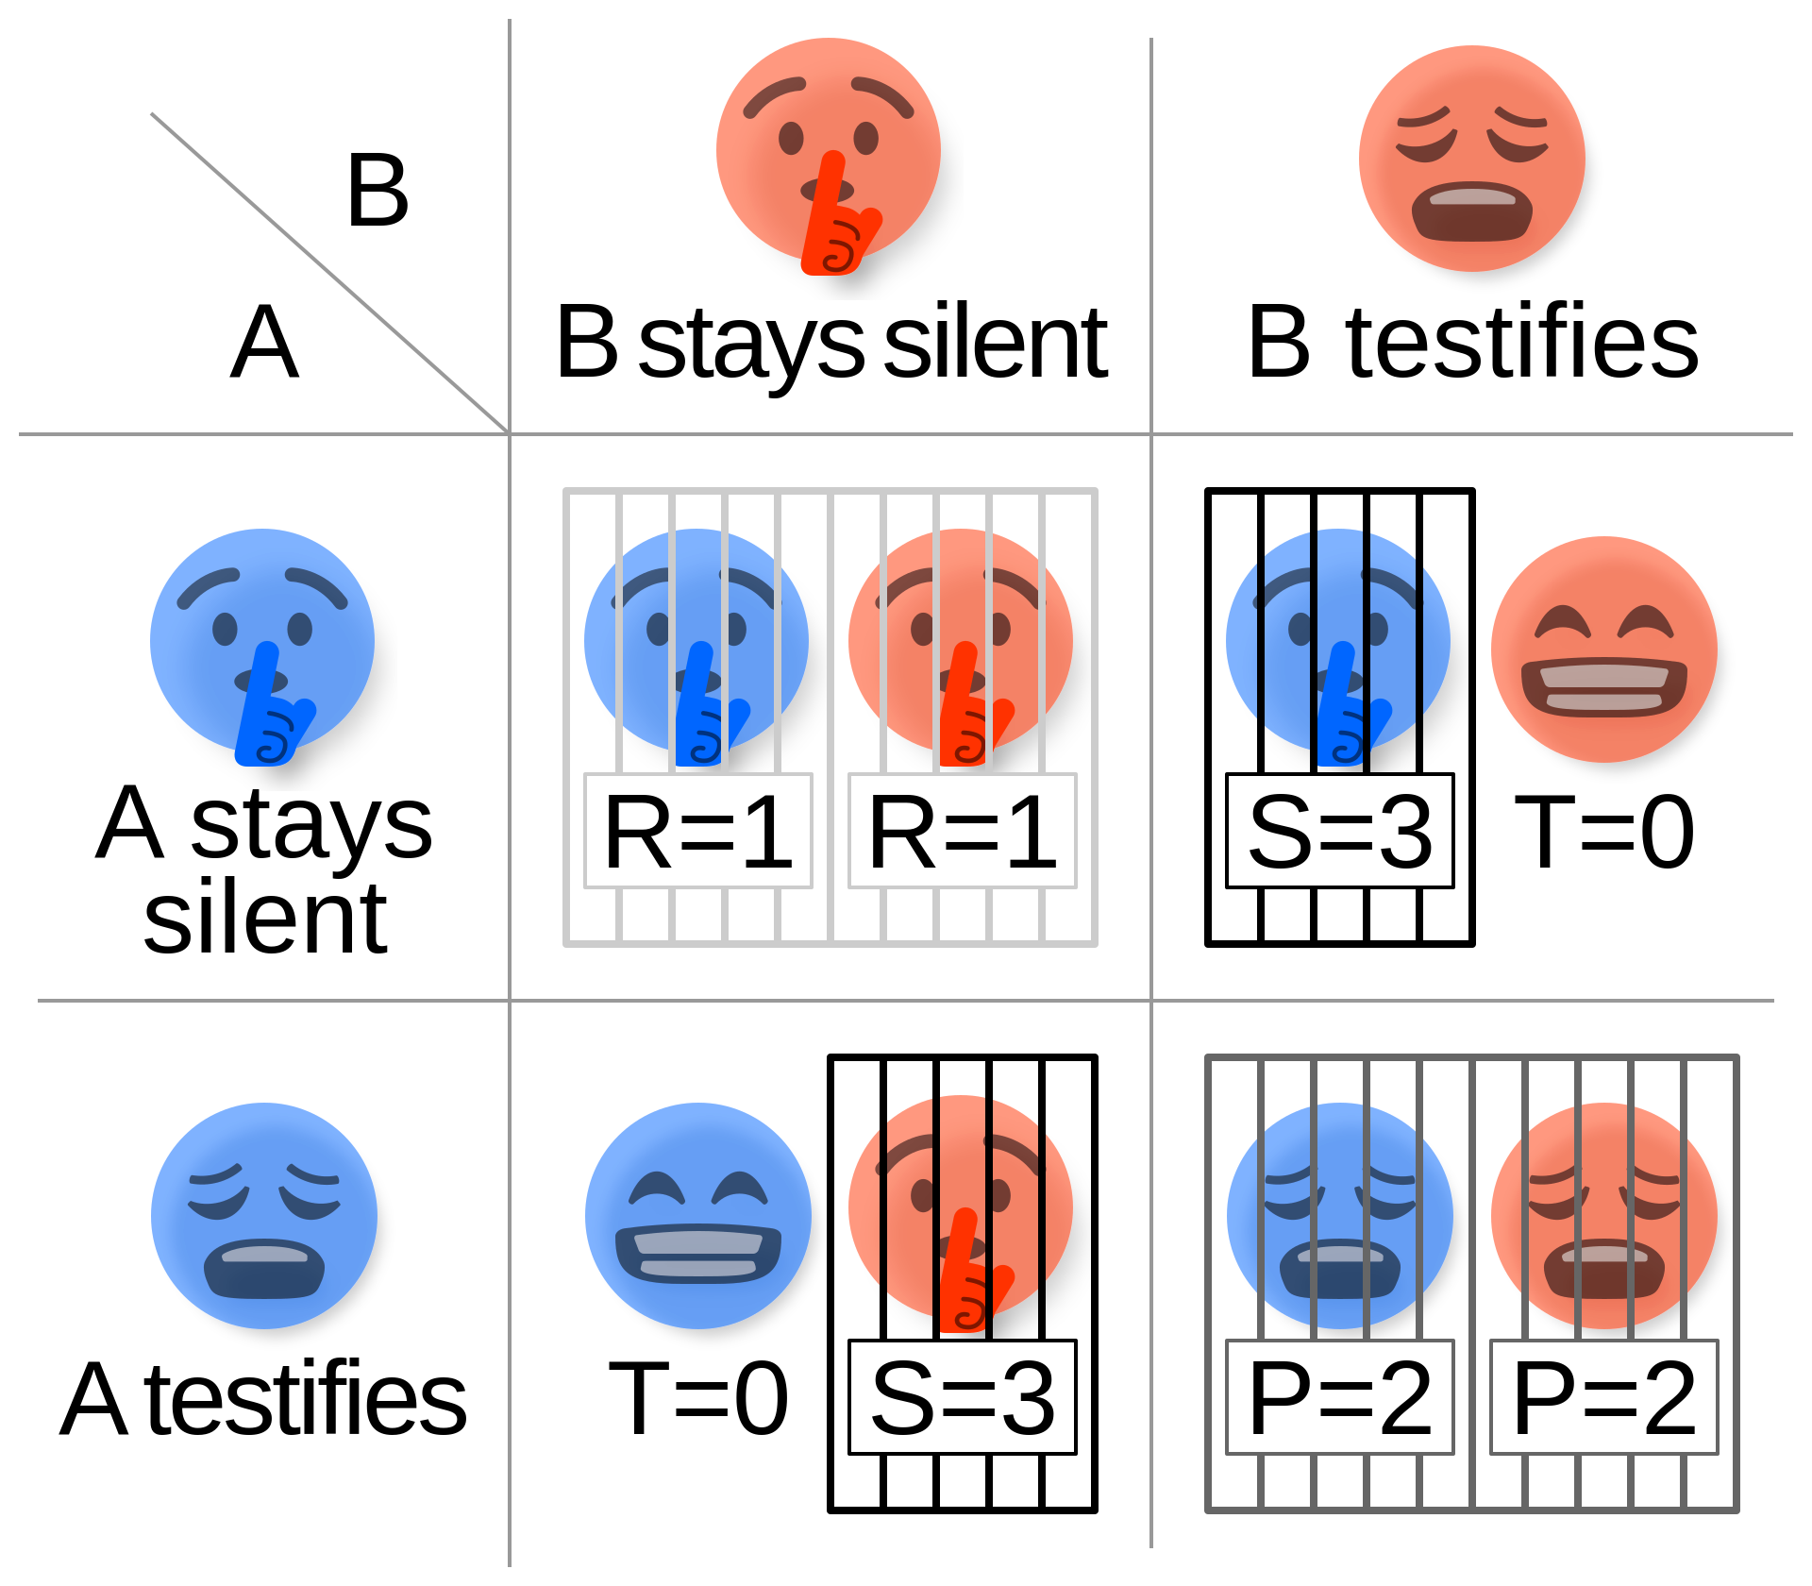
Our research proposal on LLM agents and how you can contribute to it
Background:
Social Dilemmas. The classic Prisoner’s dilemma example:
To increase our understanding of the alignment of LLM agents by analyzing their behavior on sequential social dilemma games.

Slide 35
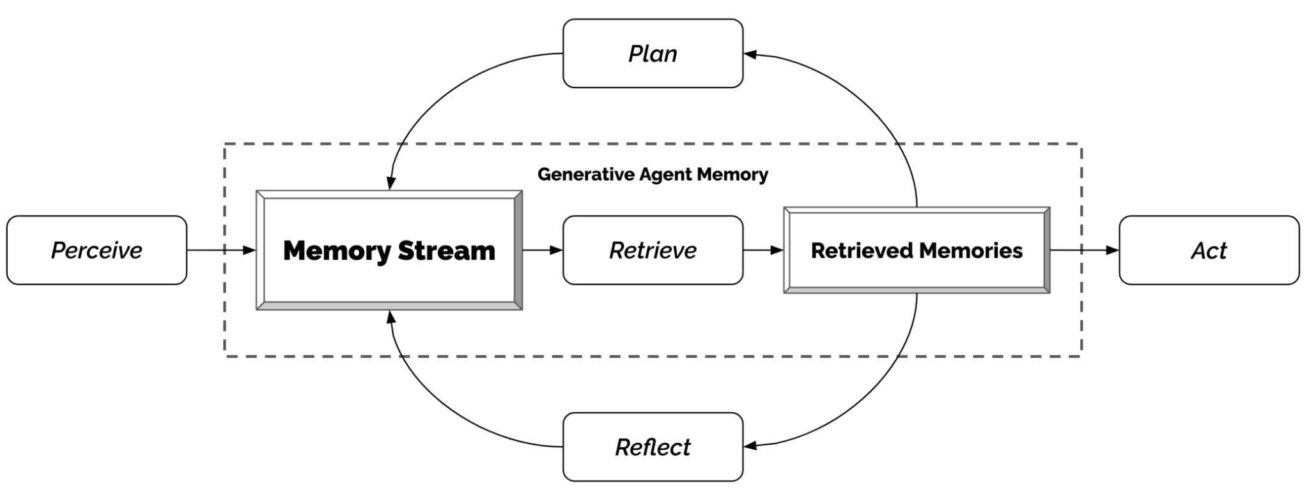
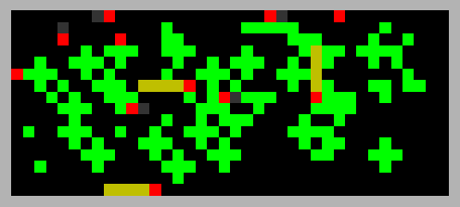
Our research proposal on LLM agents and how you can contribute to it
What we (which might include you) will do:
Use an open source LLM to implement the LLM-agent architecture from Park et al.
Design an experimental protocol to apply it to the Commons’ Game, a sequential social dilemma.
You can see further details in the draft of our proposal (it has to be updated).

Slide 36
References
Generative Agents: Interactive Simulacra of Human Behavior. The AI community paper, and our chosen agent architecture (with possible modifications).
Voyager: An Open-Ended Embodied Agent with Large Language Models. The minecraft-playing agent.
A multi-agent reinforcement learning model of common-pool resource appropriation. Our chosen testing environment.
LLM Powered Autonomous Agents. A nice blog on the topic of LLM agents.

Slide 37
Project proposal:
Dixit playing AI

Slide 38
Our research proposal on Dixit playing AI and how you can contribute to it
What we (which might include you) will do:
Design an AI that can be the storyteller. We might use CLIP interrogator (an image to text model) + an LLM or a multi-modal LLM
Design an experimental protocol to benchmark the performance of our models.

